Slide 1



The World Database on Protected Areas (WDPA)
A Complete Overview

Slide 2
Outline
1) Introduction
2) What is the WDPA?
3) How is the WDPA compiled?
4) Uses of the WDPA
5) Future of the WDPA

Slide 3
1. Introduction

Slide 4
What is a Protected Area ?
IUCN (Dudley, 2008; 2013)
“A clearly defined geographical space, recognised, dedicated and managed, through legal or other effective means, to achieve the long-term conservation of nature with associated ecosystem services and cultural values”
CBD definition (CBD/Article 2)
“geographically defined area which is designated or regulated and managed to achieve specific conservation objectives”.
There is agreement that the two definitions are equivalent.
Notes:
Lopoukhine & Dias (2012) PARKS 18.1: 5-8

Slide 5
Why Protected Areas are important?
Achievement of Target 11 of the Convention on Biological Diversity (CBD 2011-2020)
Their efficacy in ameliorating biodiversity loss and supporting biodiversity growth is well established: (Joppa et al., 2008; Hill et al., 2015).
Protected areas-”when they are well managed”-can provide a myriad of values and benefits to human populations that are critical to socioeconomic development including ecosystem services delivery.
Examples of ecosystem services include:
Provisioning services: food and water security
Regulating services: water and climate regulation, including Disaster Risk Reduction
Supporting services: soil formation and nutrient cycling
Cultural services: spiritual and religious/ recreational and educational

Slide 6

Protected Areas in Conservation Policy
State parties to the CBD have agreed to expand the global protected area from 13% to 17% of the world’s land surface by 2020 (Aichi Target 11).
Aichi Target 11:
By 2020, at least 17 per cent of terrestrial and inland water, and 10 per cent of coastal and marine areas, especially areas of particular importance for biodiversity and ecosystem services, are conserved through effectively and equitably managed, ecologically representative and well connected systems of protected areas and other effective area-based conservation measures, and integrated into the wider landscapes and seascapes

Slide 7
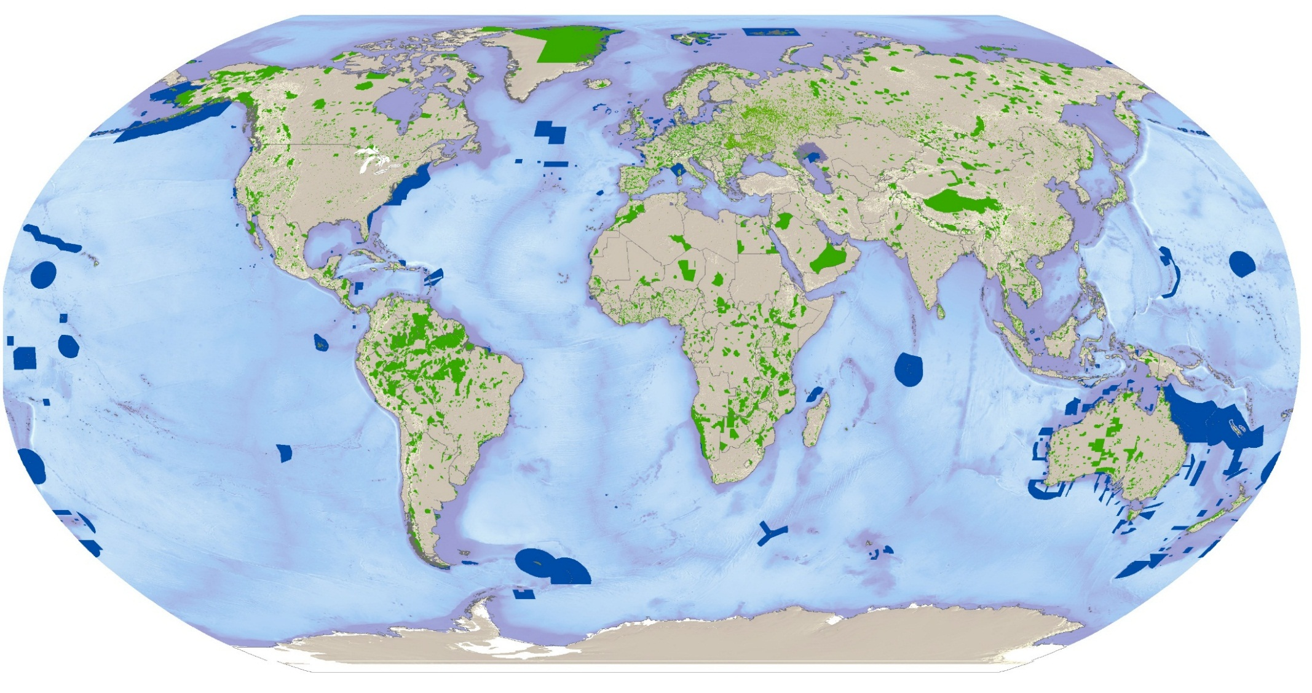
Global Protected Area Network Coverage
Spatial distribution of the world’s protected areas
March 2015:
217,300 protected areas from 238 countries and territories
Source: UNEP-WCMC 2014

Slide 8
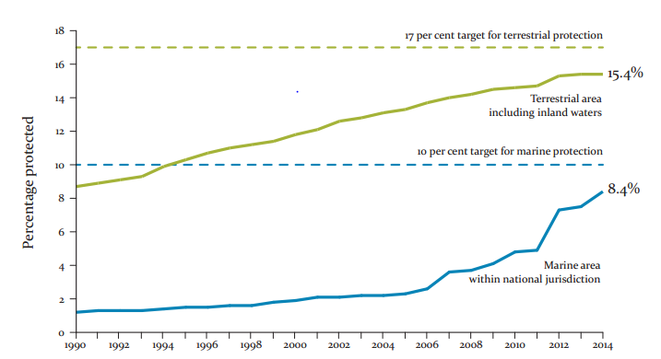
Global Protected Area Network Coverage
15.4% of the all terrestrial areas including inland waters and 8.4% of global marine areas within national jurisdiction were covered by protected areas.
Juffe-Bignoli et al. 2014

Slide 9
2. What is the Word Database on Protected Areas? (see section 1 & 2 in WDPA Manual)
UNEP-WCMC (2015) World Database on Protected Areas User Manual 1.0. UNEP-WCMC: Cambridge, UK

Slide 10
What is the WDPA?
The World Database on Protected Areas (WDPA) is a joint project between the United Nations Environment Programme (UNEP) and the International Union for Conservation of Nature (IUCN).
It is compiled and managed by the UNEP World Conservation Monitoring Centre (UNEP-WCMC), in collaboration with governments, non-governmental organisations, academia and industry.
The WDPA, is the only global database of marine and terrestrial protected areas, comprising both spatial data (i.e. boundaries and points) with associated attribute data (i.e. tabular information).
It is made available online through Protected Planet (www.protectedplanet.net) where the data is both viewable and downloadable.
It is updated monthly

Slide 11
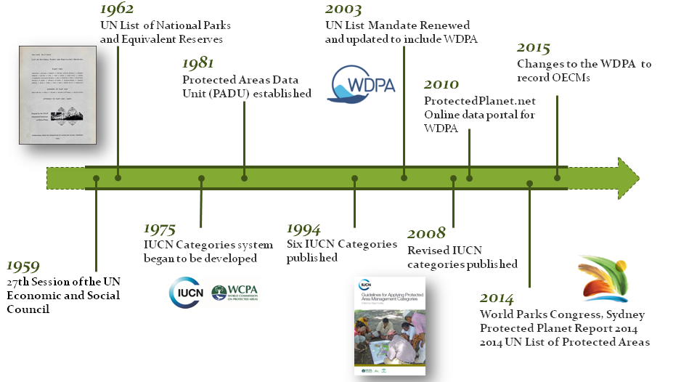
The WDPA’s history

Slide 12
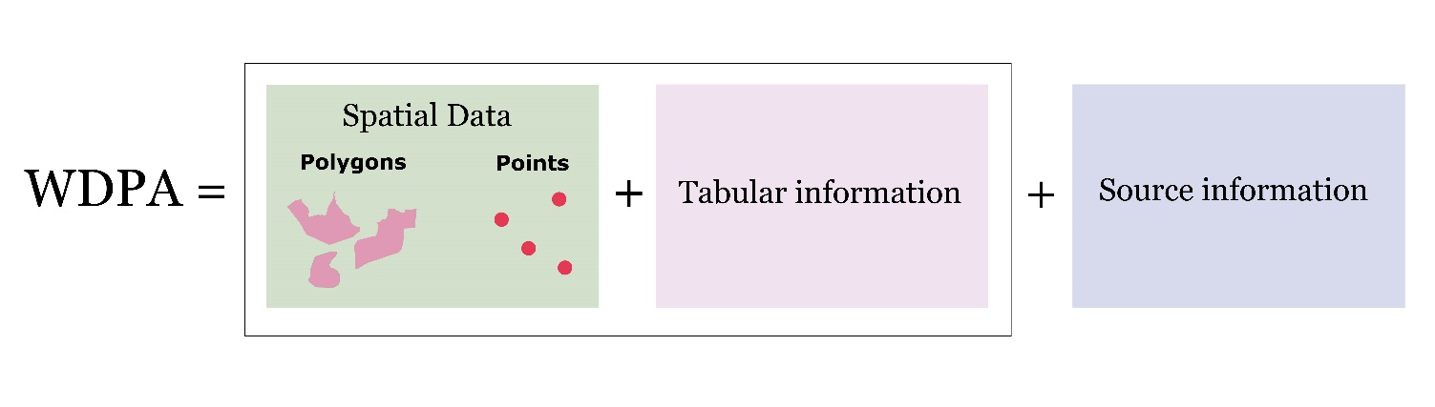
WDPA Data Structure
(See section 1.4 of the WDPA Manual)
The WDPA is based on the Geographic Coordinate System: World Geodetic Survey (WGS) 1984. Each protected area in the WDPA is either represented as a polygon boundary, or if unavailable, a point location.

Slide 13
Attribute Information
Minimum attributes
Complete attributes
Name
Original Name
Parent ISO3
ISO3
Designation
Designation Type
Marine
Reported Marine Area
Reported Area
Status
Status Year
Protected Area definition
Assigned by UNEP-WCMC
Designation (English)
Sub-National Location
IUCN Category
Governance Type
No take
No take area
Management Plan
Management Authority
Ownership Type
WDPA ID
WDPA PID
METADATA ID
GIS area
GIS marine area
International Criteria
Verification
Restrictions (not publicly available).
There are a minimum set of attributes which are deemed crucial for the validity of the WDPA, including ownership and traceability.

Slide 14
Key attributes: Designation type
“National”
National laws
“Regional”
Natura 2000
“International”
World Heritage Convention
RAMSAR Wetlands
Regional Seas Conventions
Man and Biosphere Reserves
Privately Protected Areas
ICCAs
The designation type is the category or type of protected area as legally/officially designated or proposed. In cases where a conservation area has not been legally/officially designated or proposed Not Applicable can be used.
Sites can be important at a national or international level, but still not be designated as a protected area under an international convention or agreement.

Slide 15
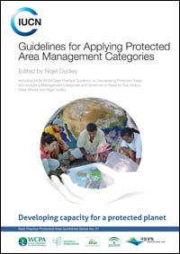
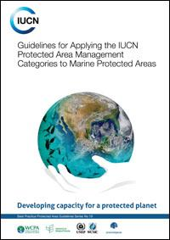
IUCN Standards in the WDPA (See section 2 of the WDPA Manual)
The IUCN Protected Area Management Categories help classify protected areas based on their primary management objectives (Dudley 2008)
The IUCN Governance Types classify protected areas according to who holds authority, responsibility and accountability for them (Borrini-Feyerabend et al. 2013).

Slide 16
IUCN Protected Area Management Categories
Ia | Strict nature reserve
Ib | Wilderness area
II | National park
III | Natural monument
IV | Habitat/species management area
V | Protected landscape/seascape
VI | Protected area with sustainable use of natural resources
 | Not Applicable
 | Not Applied
 | Not recorded
Classification is according to management objectives of an area but are in no way binding on governments
Protected areas without an IUCN Management Category may have a conservation value, for example, Indigenous Peoples’ and Community Conserved Territories and Areas (ICCAs)
Dudley, 2008. Guidelines for Applying Protected Area Management Categories
Notes:
First called for in Yellowstone at the second World Parks Congress
System proposed in 1978
Workshop at the third World Parks Congress in Venezuela
Published in 1994
Revised guidelines published in 2008, 2013
Marine guidelines published in 2012

Slide 17
Names of Protected Areas
Many countries have categorized their National Parks under other IUCN categories due to differences in their objectives. This does not mean that it has to be managed according to the guidelines under category II.
Ia | Swiss National Park | Switzerland
Ib | Everglades National Park | USA
II | Białowieża National Park | Poland
III | Victoria Falls National Park | Zimbabwe
IV | Vitosha National Park | Bulgaria
V | Yorkshire Dales National Park | UK
VI | Etniko Ygrotopiko Parko | Greece
Not recorded | Burren National Park | Ireland

Slide 18
Governance Type
Governance: The interactions among structures, processes and traditions that determine how power and responsibilities are exercised, how decisions are taken and how citizens or other stakeholders have their say.
Federal or national ministry or agency | For-profit organizations
Sub-national ministry or agency | Indigenous Peoples
Government delegated management | Community Conserved Territories and Areas (ICCAs)
Transboundary governance
Collaborative governance | Not reported
Joint governance
Individual landowners
Non-profit organisations
Borrini-Feyerabend, G., N. Dudley, T. Jaeger, B. Lassen, N. Pathak Broome, A. Phillips and T. Sandwith (2013).

Slide 19
Beyond National Parks: WDPA Case Study
1) Indigenous Peoples’ and Community Conserved Territories and Areas (ICCAs)
Defined by their relationship with and dependence on natural resources. ¹
ICCAs should exhibit three key characteristics: a) Community: A well defined people or community with a close relation to a defined location.
b) Decisions: The people or community is the major player in decision-making regarding the site.
c) Conservation: The people’s or community’s decisions lead to the conservation benefits.
1 See Convention on Biological Diversity document Guidance for the Discussions Concerning Local Communities within the Context of the Convention on Biological Diversity (ref. UNEP/CBD/AHEG/LCR/1/2).

Slide 20
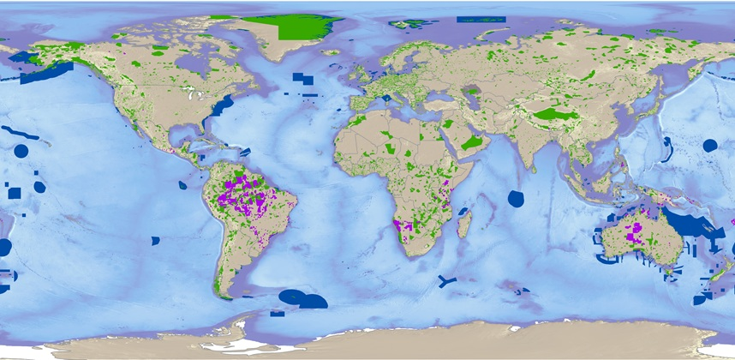
Beyond National Parks: WDPA Case Study
1) Indigenous Peoples’ and Community Conserved Territories and Areas (ICCAs)
As of March 2015 ICCAs occurred in 36 countries in the WDPA
91% are in just 10 countries.
Strongly biased to where the government recognises ICCAs (70% reported by government sources).

Slide 21
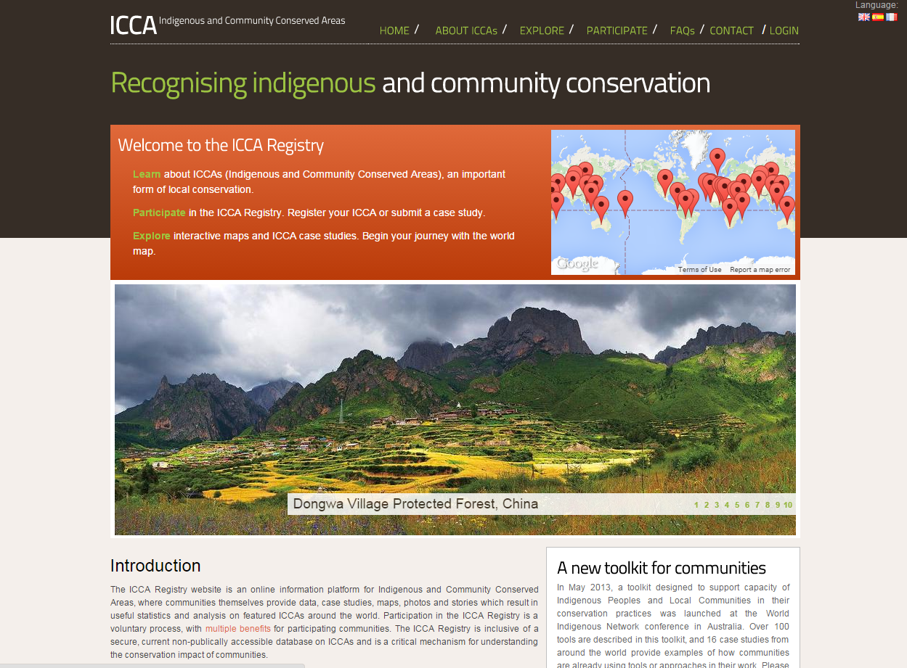
ICCAs and Aichi Targets
ICCAs are relevant to all Aichi Targets, but Targets 1,5,7,11,13,14 and 18 cannot be achieved without ICCAs (Kothari & Neumann, 2012).
ICCAs may be protected areas or other effective area-based conservation measures (OECMs): sites that don’t meet the IUCN protected area definition but are still beneficial for conservation.
Amalgamated in the ICCA Registry and in the WDPA, both managed by UNEP-WCMC.
http://www.iccaregistry.org/
Notes:
Ref: Kothari, A. and Neumann, A. 2014. ICCAs and Aichi Targets: The Contribution of
Indigenous Peoples’ and Local Community Conserved Territories and Areas to the Strategic Plan
for Biodiversity 2011-20. Policy Brief of the ICCA Consortium, No. 1, co-produced with CBD Alliance,
Kalpavriksh and CENESTA and in collaboration with the IUCN Global Protected Areas Programme.

Slide 22
3. How is the WDPA compiled?
(See section 3 of the WDPA Manual)

Slide 23
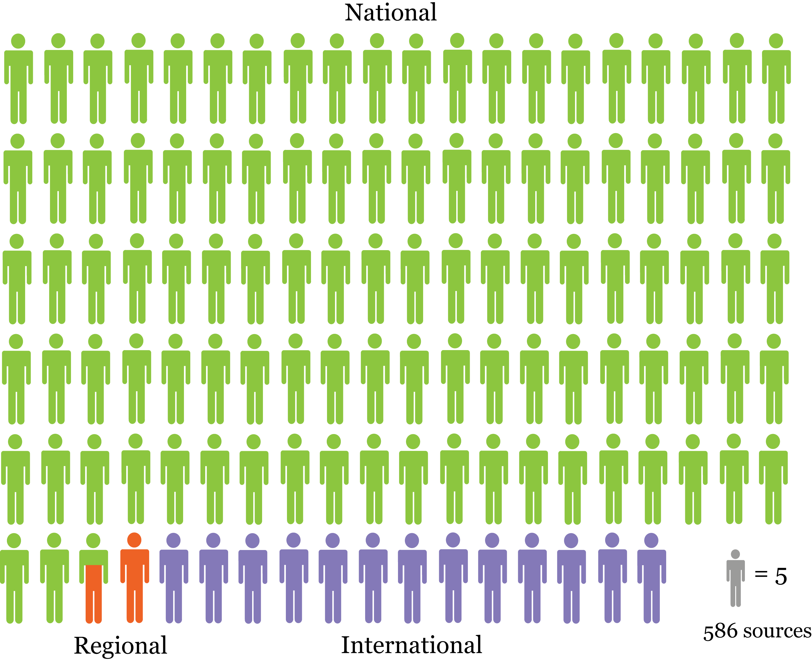
The data providers
Governments
WDPA
International
Regional
NGOs and Others

Slide 24
The Quality assurance & verification process
WDPA
State verified
Expert verified
State sources
Expert sources
Other sources
Supporting processes:
Data Contributor Agreement
Statement of Compliance
The state can be asked to verify data from expert sources if the data provider requests this.
Data from all other sources must go through a verification process before entering the WDPA.
Data provider determines whether their data are verified by the state or by experts.

Slide 25
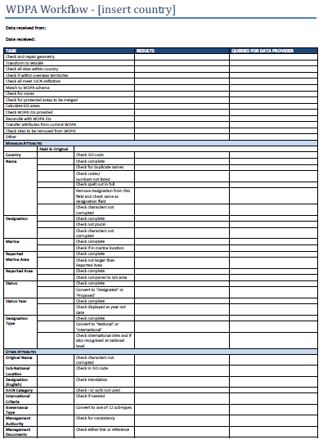
WDPA Update Process
Build
Capacity
Receive Data
Validate & Format Data
Reconcile
Data
Update WDPA
Request
Validation by country

Slide 26
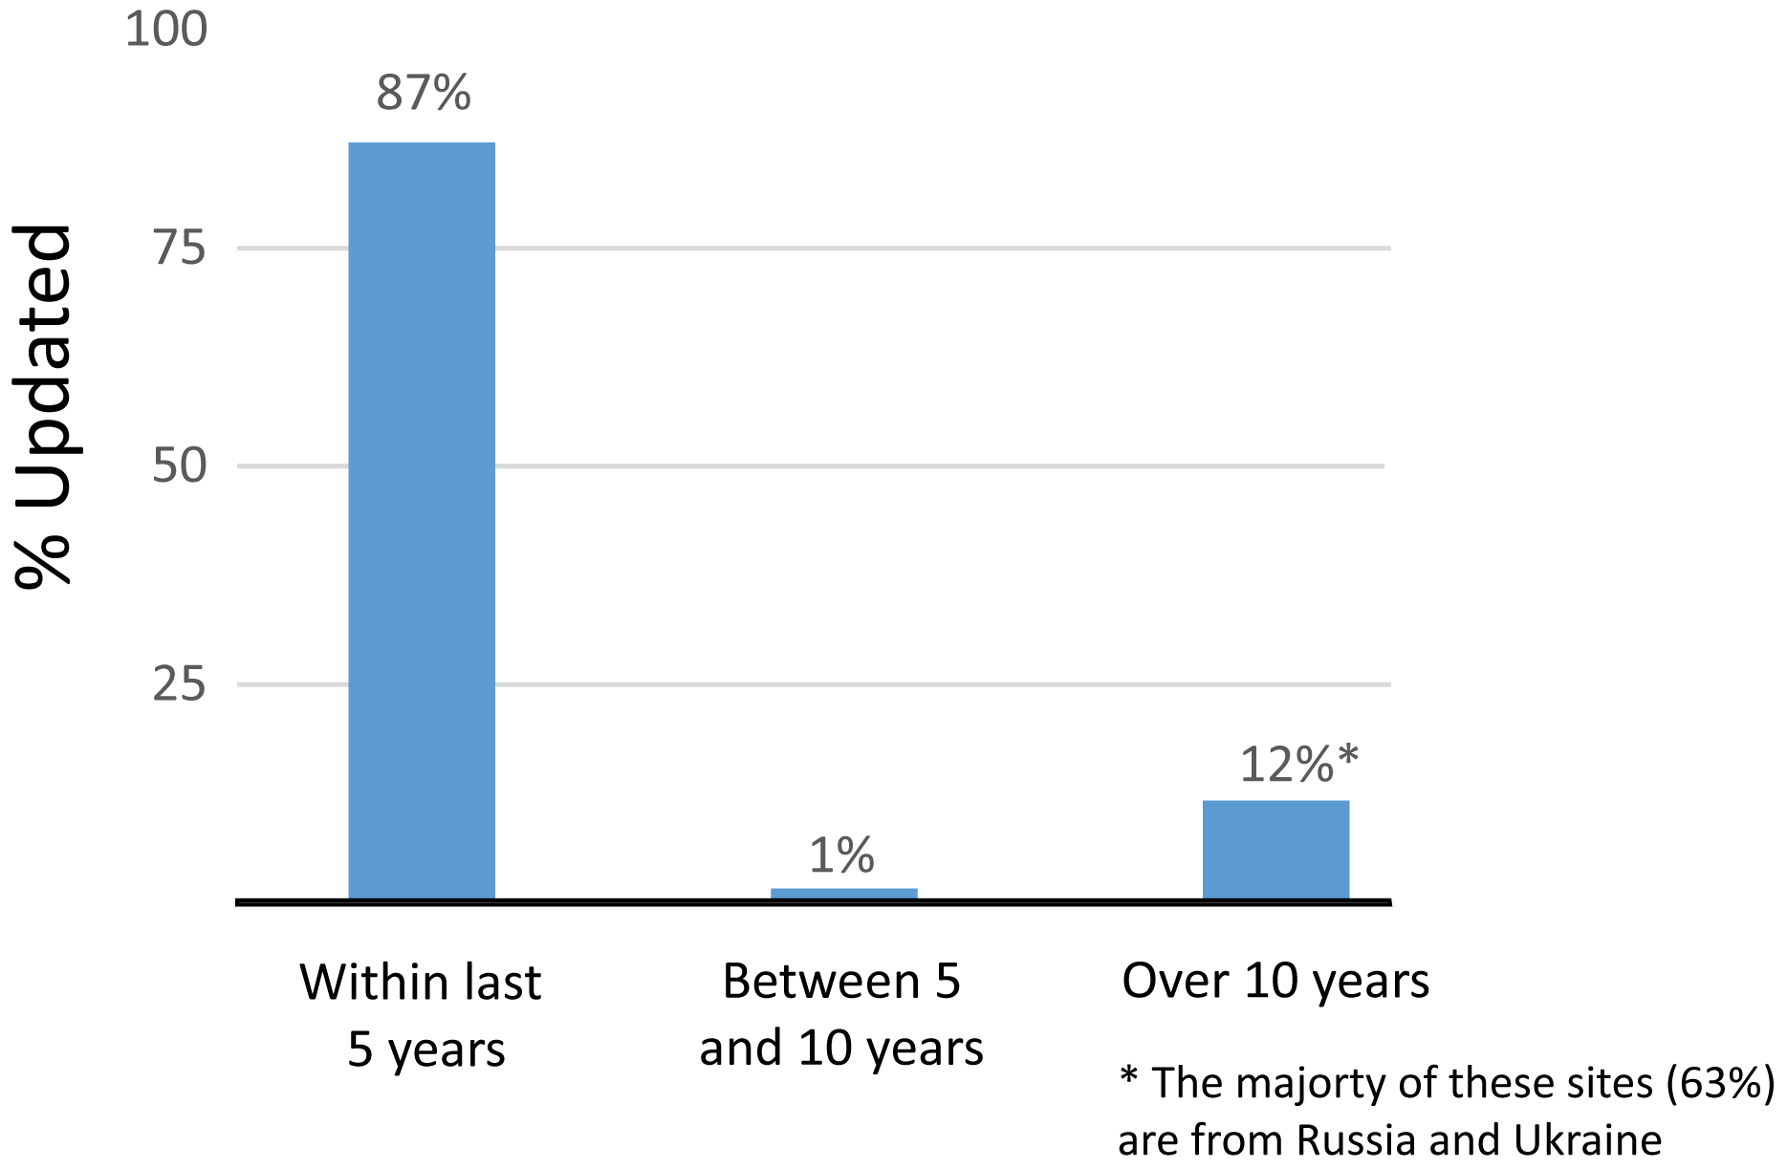
WDPA Update Process
The vast majority of the WDPA has been updated in the last five years
161,195 records were updated in 2014 alone

Slide 27
4. Using the WDPA (See Section 4 of the WDPA manual)

Slide 28
WDPA users
Conservation practitioners & scientists:
Provides vital information to implement conservation objectives, e.g. Regional planning authorities
Enables researchers to analyse trends and projections in the conservation estate
Businesses:
Improves efficiency and discourse between stakeholders, e.g. extractive industries
Governments:
Measure progress towards regional, national and global targets

Slide 29
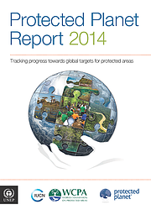
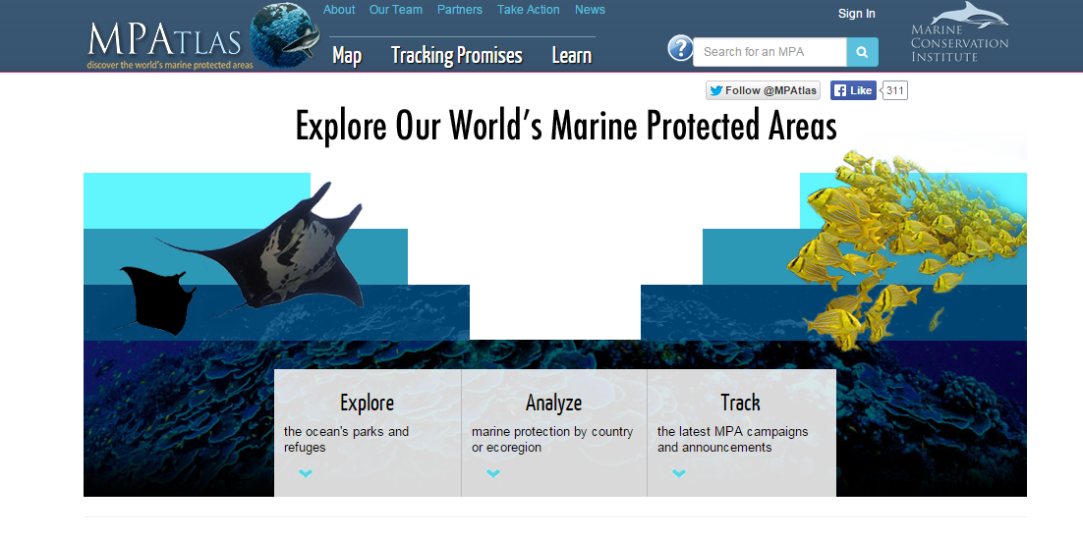
Use of the WDPA
Publications:
UN List of Protected Areas (2014)
Millennium Development Goals (Goal 7)
Protected Planet Reports (2012, 2014)
CBD Global Biodiversity Outlook 4
UNEP Global Environment Outlook
Global Reporting Initiative
Online systems:
MPA Atlas
DOPA
Protected Planet

Slide 30
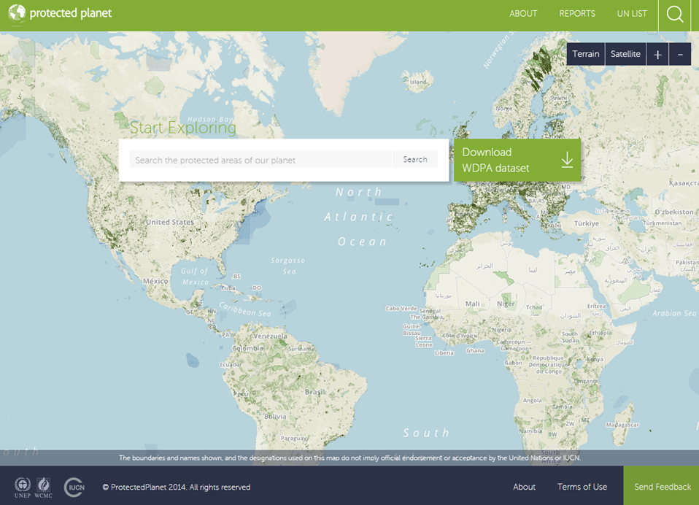
Protected Planet Website where data can be viewed and downloaded (see section 4.1 in WDPA Manual)

Slide 31
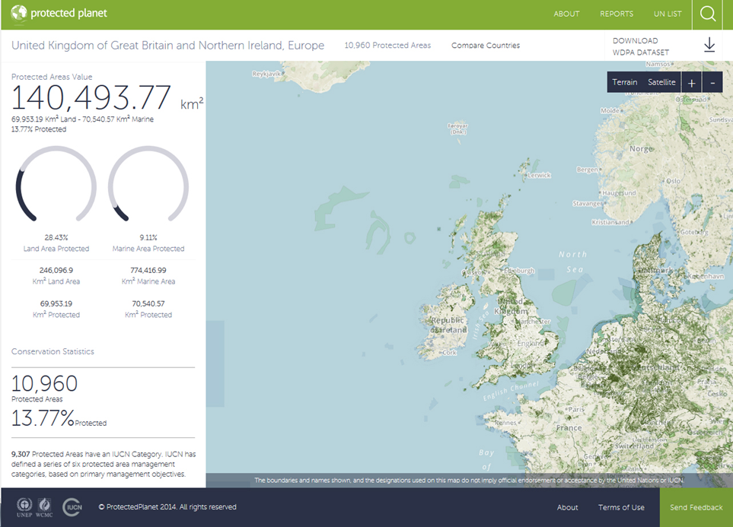

Slide 32
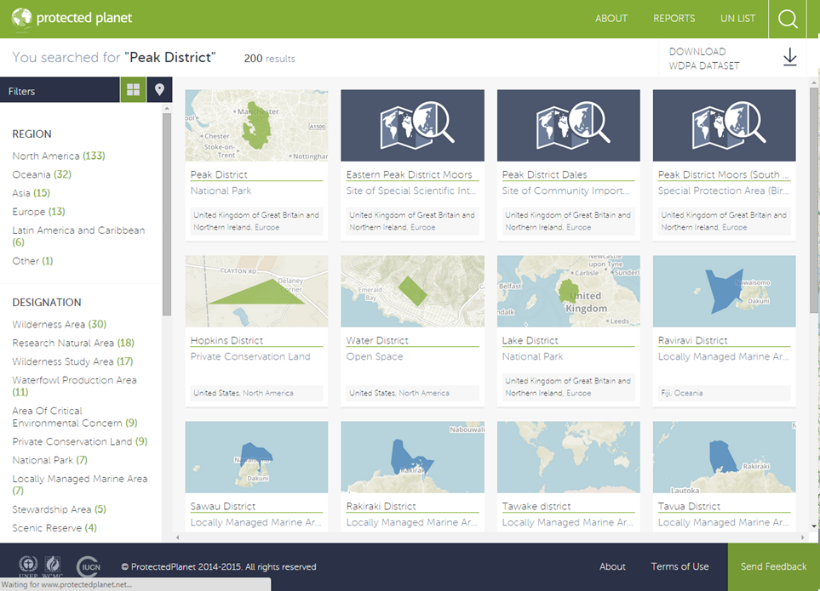

Slide 33
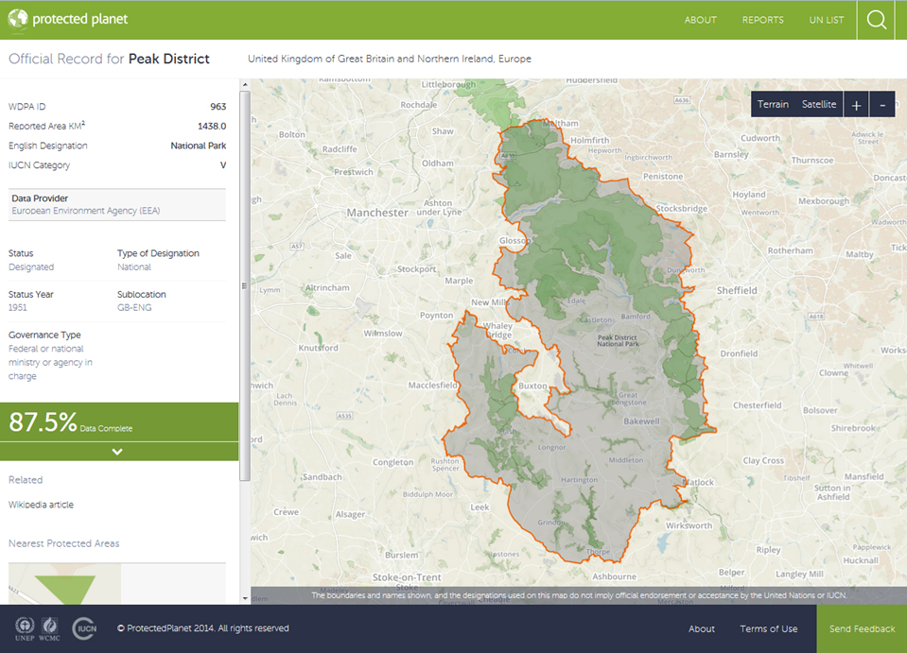

Slide 34
Using the WDPA for analyses
(See Section 4.5 of the WDPA manual)
Using the WDPA for research, developing indicators, and reporting usually requires processing the WDPA in various ways.
It is highly recommended that all parties interested in using the WDPA consult the WDPA manual.
The WDPA manual lists common problems encountered whilst using the WDPA and best practice solutions to these problems.
For any queries regarding use and steps for processing of the database please contact the WDPA team at protectedareas@unep-wcmc.org.

Slide 35
WDPA Data-Cautions and Constraints
Gaps in some of the WDPA attributes do exist, even among the minimum required attributes.
The size of the WDPA, can hinder or slow down analysis if the whole WDPA is used with insufficient computational resources.
The WDPA is a snapshot of protected areas status at the time of a WDPA release. The global protected area system is constantly changing, with sites or their attributes being added, removed and changed on a constant basis.

Slide 36
5: Future of the WDPA

Slide 37
Challenges
Reporting is voluntary:
Mandated by the CBD
Inconsistent interpretation of definitions
Data accuracy:
Under reporting in the marine realm
Time delay in entering the WDPA
What to do with out-dated data or inaccurate data, e.g. points
Improving the representation of OECMs and ICCAs
Restrictions:
Sensitivity and privacy for certain sites – limited pubic access
Disputed territories continually a source of contention

Slide 38
Future Directions
Maintain ProtectedPlanet.net and continue collating data
UNEP-WCMC will continue to keep the WDPA up-to-date as possible is a full-time responsibility, and improving the quality and potential requires even more input.
Continue reporting and analysis:
UNEP-WCMC will continue to produce: Protected Planet reports, national level reports and targeted analyses on protected area topics.
Expand linkage with other data sources:
Develop links in ProtectedPlanet.net to relevant site pages on Protected Area Management Effectiveness, the IUCN Red List of Threatened Species and legal information, e.g. ECOLEX.

Slide 39
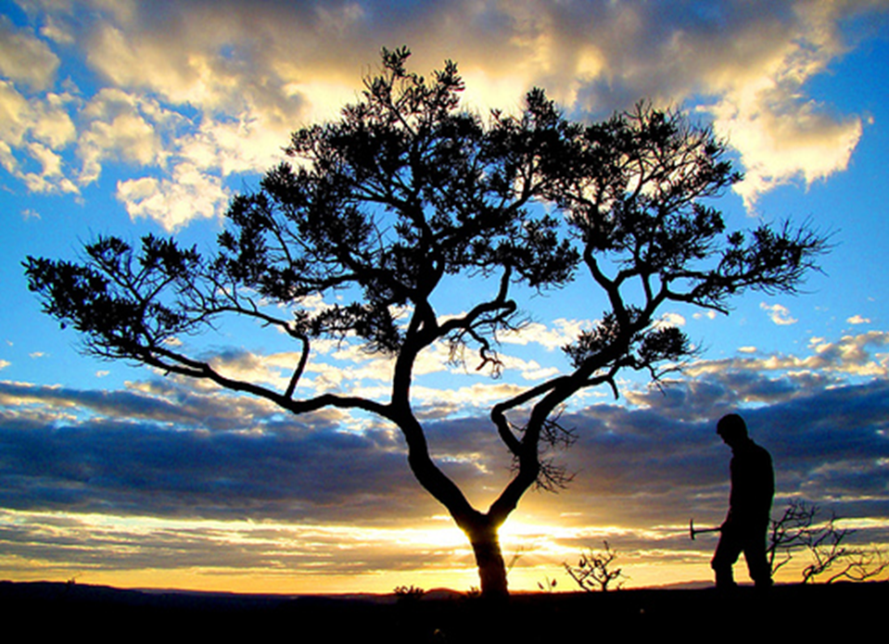
Thank you! protectedareas@unep-wcmc.org Twitter: @unepwcmc
Source: //www.flickr.com/photos/ana_cotta

